Slide 1
Assignment 3
Encryption and Decryption

Slide 2
ASCII
Every character and special character has a corresponding ASCII value which is unique

Slide 3
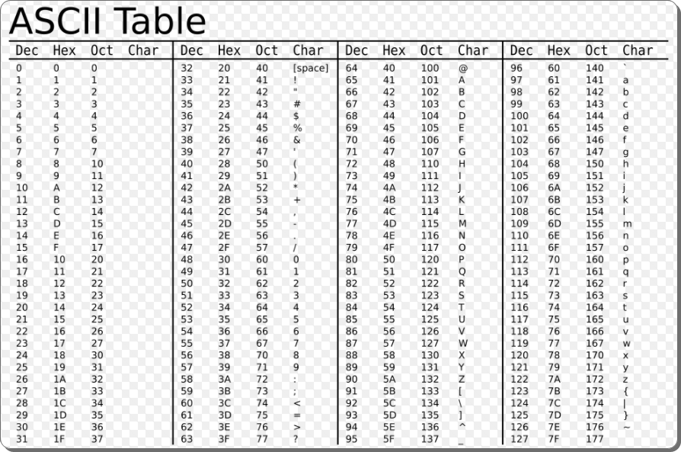

Slide 4
If (‘A’ > 68)
If (65 > 68)
is same as

Slide 5
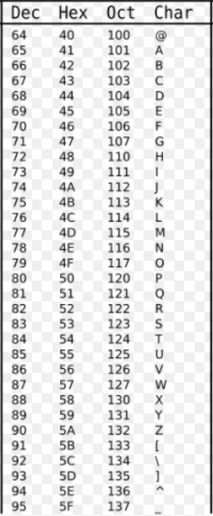
Caesar Cipher
String to be encrypted: “ABC”
Key: 1
ABC --->
65 66 67 ---->
66 67 68
Encrypted String: “BCD”

Slide 6
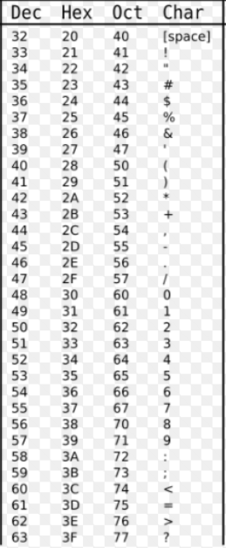
Bellaso cipher
String to be encrypted: “+*+*”
Key: “AB”
+ * + *
A B A B
+*+* --->
43 42 43 42
--------->
43 + 65 = 108
108 - 64 (Range) = 44
Encrypted String: “,,,,”

Slide 7
